Slide 1


Data Governance @ SneakerPark
Prepared by:
Submitted on:

Slide 2
Background
SneakerPark is an online shoe reseller that allows people to buy and sell used and new shoes. Buyers can bid for shoes or buy them outright, and sellers can set a price or sell to the highest bidder.
Each buyer and seller must have an active account in order to sell, bid, or purchase sneakers using SneakerPark’s website.
SneakerPark authenticates the shoes before shipping them to the buyer, so before listing an item, the seller must ship it to SneakerPark’s warehouse. Upon receipt, SneakerPark assigns an item number to each pair of sneakers and notifies the seller that they are now free to list their item. If the item is not listed within 45 days, SneakerPark returns it to the seller and sends an invoice to the seller for the shipping cost.
If the item is found to be inauthentic or in an unacceptable condition, it is also returned back to the seller in a similar fashion.
When the item sells, the buyer’s account is credited with the purchase price minus the SneakerPark service fee and shipping fees to deliver the item to the buyer.
Currently, SneakerPark only supports sales within the United States.

Slide 3
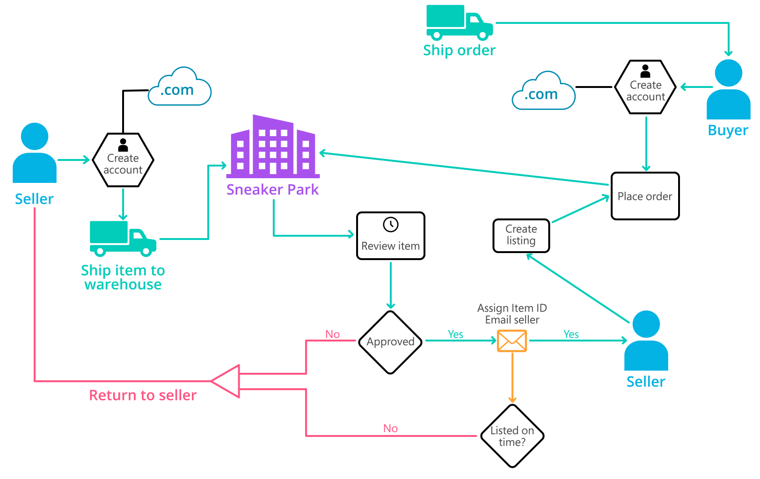
Background (cont’d)
Below you can see a diagram that will hopefully help you visualize some of SneakerPark's business processes. Keep in mind that it does not capture ALL processes and every nuance, but simply serves as another artifact to use in your project.

Slide 4
Step 1
Enterprise Data Catalog Part 1: Enterprise Data Model

Slide 5
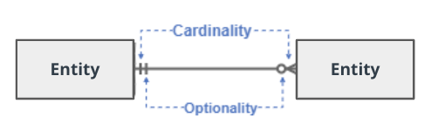
Create a conceptual data model that will provide SneakerPark with a holistic view of its data systems and help you grasp the organization's important entities and relationships, which will be instrumental as you move further in the project. You can use Lucidchart or any other diagramming tool of your choice, but please use the Crow’s Foot/IE Notation and please be sure to indicate both cardinality (the type of a relationship such as 1:N or N:N) and optionality (whether the relationship is optional or mandatory).

Slide 6
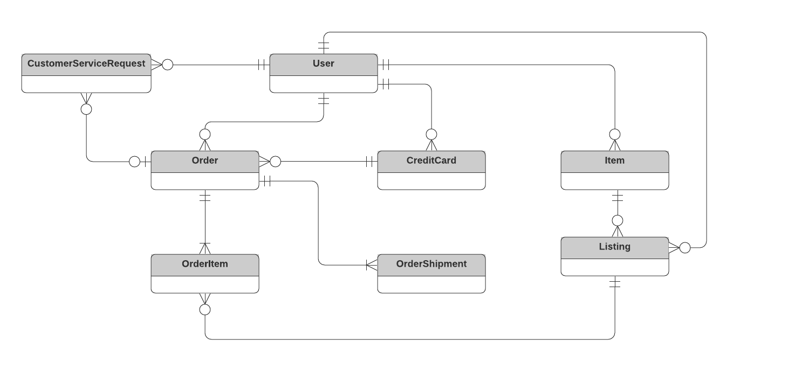
Replace the example below with your own solutions (obviously feel free to take more space):

Slide 7
Step 2
Enterprise Data Catalog Part 2: Metadata

Slide 8
Create the first version of the Metadata Catalog by documenting the metadata from all systems in the "Data Dictionary" and the “Enterprise Data Catalog” tabs of the provided Sheets template.
Please note that you are required to fill out all fields in both tabs.

Slide 9
Step 3
Data Quality
Part 1: Profiling and Cleansing

Slide 10
Profile the data to identify at least 3 data quality issues you see in the data. Also provide at least 1 data quality issue that you haven’t yet seen in the data, but can foresee occurring in the future. Based on the issues you’ve identified, come up with the data quality rule for each data quality issue, including for the one that you foresee.
Make sure you fill out all columns in the "Data Quality Issues" tab with your answers in the provided Sheets template.

Slide 11
Step 4
Data Quality
Part 2: Monitoring

Slide 12
Using the metrics you've created in the last step, please create a mock-up of a data quality monitoring dashboard that will be used to monitor the data to ensure compliance with your data quality rules.
Please make sure to label your metrics clearly on your mock-up.
Replace the example dashboard below with your own. (obviously feel free to take more space).

Slide 13
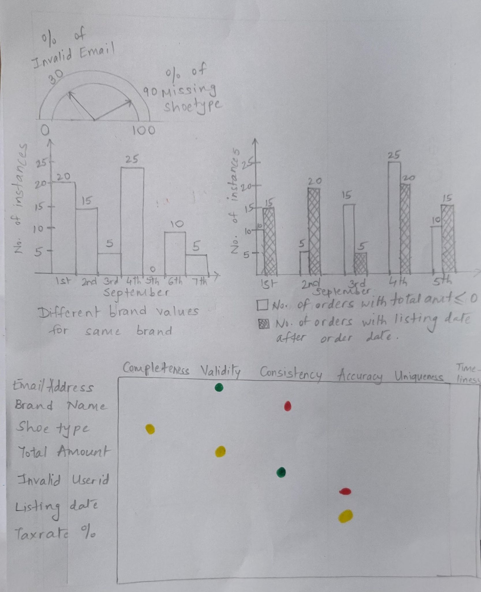

Slide 14
Step 5
Master Data Management
Part 1: MDM Architecture

Slide 15
Based on what you’ve read about SneakerPark’s systems and business model, sketch out a proposed MDM implementation architecture, and write a detailed explanation of why you chose this specific approach.
Tip: Think about how your plan and its implementation might affect existing systems.
Replace example screenshot below with your own solutions (obviously feel free to take more space).
Next, please write at least a paragraph explaining your choice.

Slide 16
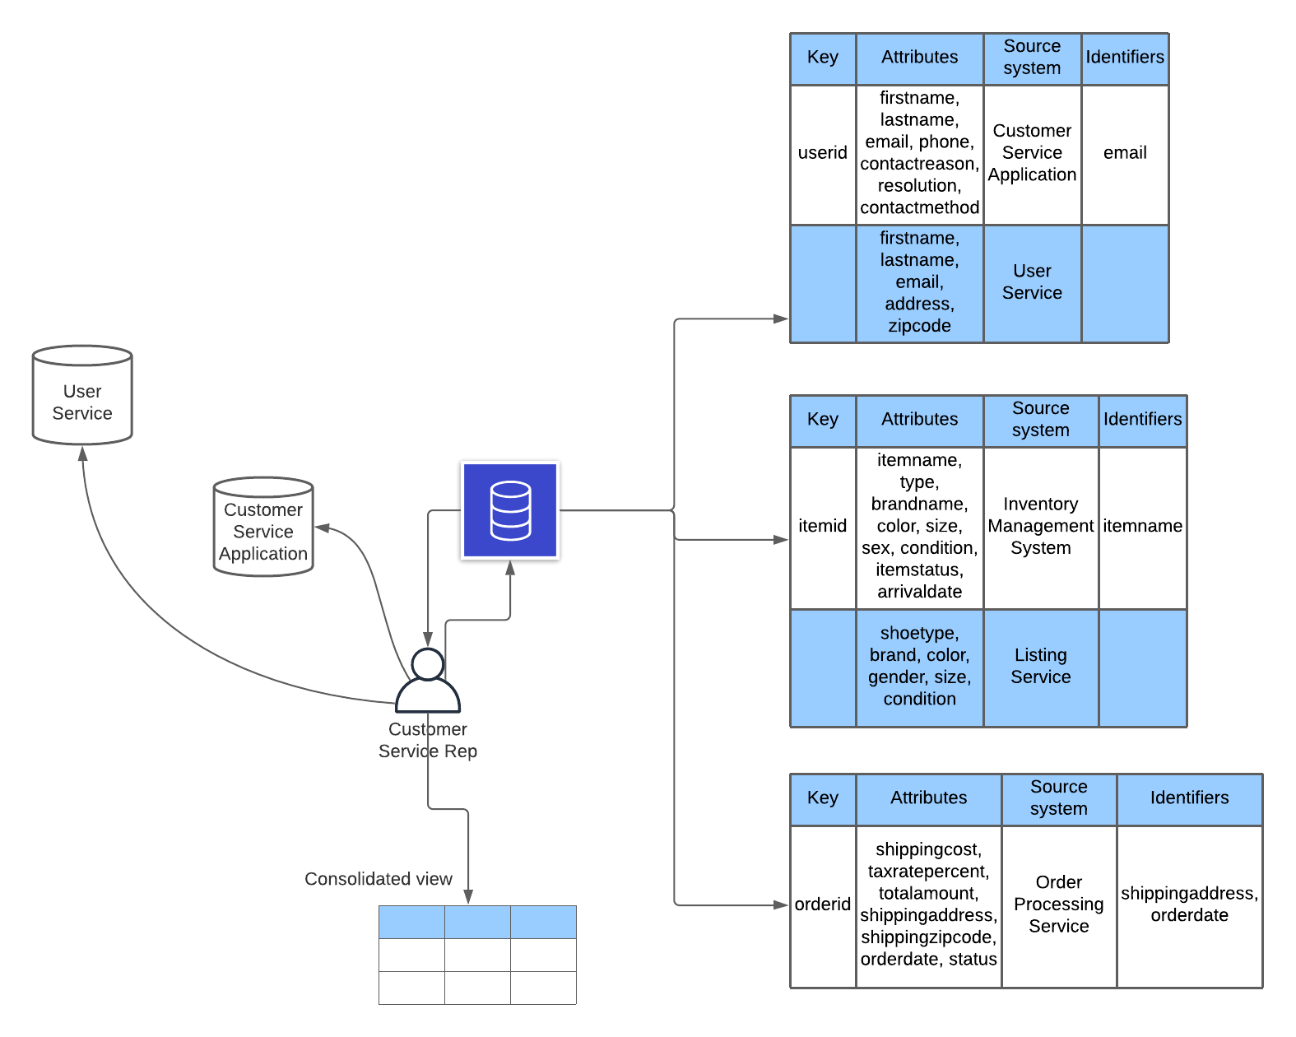
MDM Architecture

Slide 17
Explanation:
I chose the Registry architecture style for MDM due to the following reasons :
Project Overview mentions that Phase 1 should focus on the foundational data management tools & artifacts & the Registry architecture style is a good fit for that. Also, the company wants to use a Data Warehouse in Phase2 (not in current scope) which would be a good time for the Consolidated architecture style but not right now.
The Technical Details mention that this project should be minimally disruptive to the business operation & the Registry style is the minimally-disruptive one amongst all the styles

Slide 18
Step 6
Master Data Management
Part 2: Master Record

Slide 19
In this step, you will define a set of matching rules that will be used by the SneakerPark's MDM Hub to match item and customer entities between the company's different systems.
Please come up with 4 rules - 2 for Items and 2 for Customers and list them below.
Items :
Match items by listing’s productid with item’s itemid
Match items by brand, color, sex/gender, size, condition (after standardization like converting M to Male for sex or “Open Box” to “Like New” for condition)
Customers :
Match customers by userid across customerservicerequests & users tables
Match customers by firstname, lastname & email

Slide 20
Step 7
Data Governance:
Roles and Responsibilities

Slide 21
Write 1-2 paragraphs discussing what data governance roles and responsibilities will be necessary to oversee this new Data Management initiative. Please be sure to discuss the responsibilities in the context of at least 3 different aspects of Data Governance (such as Data Quality Management, Metadata Management, MDM, etc). Based on what you know, do SneakerPark's current employees have the necessary skills for these roles or should the company make new hires?
SneakerPark would need Data Stewards for the MDM aspect to be able to define match rules, review matching issues, review rejected records, etc. They have a SME in Jessica who can act as the Data Steward for both Items & Customers, but they might need to hire 1 more person for the Data Steward role depending on the work-load.
SneakerPark would need someone technical to create the Technical meta-data & to look into Data Quality issues & address them by working with other development teams. They’ll need to hire someone who can perform the job as they dont have anyone in that role, currently.
SneakerPark would need someone from the business to prepare & maintain the Business meta-data & they should be able to find someone from each business area to fulfil that role.

Slide 22
Standout Suggestions

Slide 23
Create a Business Glossary for SneakerPark and define common terms such as Item, Buyer, etc. Think and discuss how SneakerPark can improve on the consistency of the terms that its systems currently use. (You can use the “Business Glossary” tab of the same Sheets template you’ve been using for the other parts of this project to get you started.)
Document SneakerPark’s current naming conventions. Can you think of any improvements? (You can use the “Standard Naming Conventions” tab of the same Sheets template you’ve been using for the other parts of this project to get you started.) Some examples of Naming Conventions include;
Do not use spaces or special characters.
Use only LOWERCASE.
All identifier fields should end in “_id”.
Avoid acronyms and abbreviations.
Write SQL scripts for the matching rules that you’ve created in Step 6.

